Slide 1
Pseudomonadaceae Pseudomonas
The genus Pseudomonas was described more a century ago. Recent nomenclatural arrangement lead to creation of the genus Burkholderia. Both genera include aerobic, non-spore forming, oxidase positive , non-lactose ferrmentor, G- rods that grow on MacConkey agar.
Genus Pseudomonas:
Pseudomonas species have worldwide distribution. They are ubiquitous in soil, water, decaying organic matter & vegetation, but are opportunistic pathogens of animals, plants & humans. One species P. aeruginosa is commonly encountered as an animal pathogen, another species P. fluorescens is occasionally isolated from animal specimens.

Slide 2
Morphology & identification
P.aeruginosa is motile, G negative usually occurs as single or pairs.
Culture: It is an obligate aerobe & can readily grow on many types of media. Some strains hemolyze blood. P.aeruginosa forms smooth round colonies with a fluorescent greenish color due to production of pyoverdin pigment. It may produce a non-fluorescent bluish pigment (pyocyanin). Some strains produce the dark red pigment pyorubin or the black pigment pyomelanin.
P.aeruginosa can produce multiple colony types giving the impression of mixed bacteria growth. Thus it may have different biochemical & enzymatic activity & different antimicrobial susceptibility patterns. Culture from cystic fibrosis may yield P.aeruginosa that form mucoid colonies due to overproduction of alignate (exopolysacharride).

Slide 3
Growth & antigenic structure
Growth characteristics:
P.aeruginosa grow well at 37-42 C. Growth at 42 C helps differentiate them from other pseudomonads. It is oxidase positive.
Antigenic structure & toxins:
Pili (Fembriae) extended from the cell surface & promote attachment to host epithelial cells. Polysacharride capsule is responsible for the mucoid colonies in culture from patients with cystic fibrosis. The LPS is responsible for many of the endotoxic properties of the organism.
Most P.aeruginosa isolated from clinical infections produce extracellular enzymes including protease, elastase, hemolysin & heat-labile phospholipase C& heat-stable glycolipid. Many strains of P.aeruginosa produce exotoxin that causes tissue damage.

Slide 4
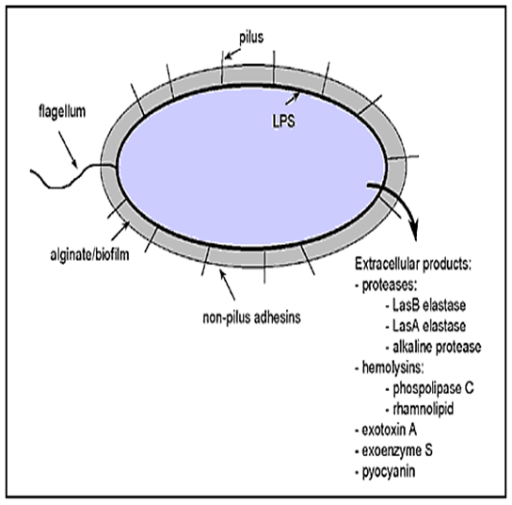

Slide 5
Disease & epidemiology
Unlike many environmental bacteria, pseudomonads have a remarkable capacity to adapt to & thrive in diverse ecological niches.
P. aeruginosa & P. fluorescens have been found in a variety of aqueous solutions & on equipment, including mastitis preparations, semen extenders, irrigation fluids, antiseptics, hydrotherapy bath & endotracheal tubes. P. aeruginosa is found infrequently as normal flora of mucous membranes &GIT of healthy animals.
The organism is an opportunistic pathogen because it rarely infects uncompromised tissues. P. aeruginosa associated disease conditions in animals are ovine fleecerot, bovine mastitis & abortion, equine metritis & corneal ulcer, canine otitis eexterna, embryo mortality in poultry, botryomycosis, septicemia, UTI, wound infection, & abscesses in variety of animals.

Slide 6
Fleece rot in sheep

Slide 7
Disease & epidemiology
Fleece rot of sheep is characterized by superficial inflammation of the skin. It is economically important because of its downgrading of wool. Predisposing factors are prolonged wetting of the fleece & conditions of high humidity. Clinically the fleece is bluish green as result of production of the diffusible pigment pyocyanine. Older lesion develop a putrefactive odor that attract flies & may result in cutaneous myiasis.
P.aeruginosa is a cause of bovine mastitis. The infection may be originated from the use of contaminated antibiotic intramammary infusion, dipping solutions or washing water. Infection can be acute, but usually chronic & resistant to treatment. In acute outbreaks, the animal may die due to endotoxemia. Chronic mastitis is characterized by low grade inflammation of the mammary gland with suclinical recurrence.
Sporadic bovine abortion & equine metritis have been associated with P.aeruginosa . Cows & mares inseminated naturally or artificially with contaminated semen may develop varying degrees of RT disease.

Slide 8
Disease & epidemiology
P.aeruginosa is a common invader of the equine cornea. Infection usually follows Minor trauma. Loss of vision may occur if cases left untreated.
Canine otitis externa caused by P.aeruginosa is infrequent. If the infection untreated, P.aeruginosa may invade the underlying tissues, causing cranial nerve damage, otitis media or interna & osteomyelitis.
P.aeruginosa is often recovered from dead poultry embryos. Severe disease outbreaks have followed egg injection with contaminated vaccines or egg dipping with antimicrobial solutions.
Botryomycosis is a granulomatous disease of the skin. Most recorded cases are caused by S. aureus, however, P.aeruginosa may also implicated in cattle, rodents & man. Trauma is an important predisposing factor for the inoculation of bacteria into tissues. In cattle lesions are reported on udder &nasopharynx.

Slide 9
Disease & epidemiology
P.aeruginosa Is an opportunistic pathogen of humans causing UTI, RTI, dermatitis, soft tissue infections, bacteremia, & variety of systemic infections. Infection is particularly a problem in patients with severe burns, cancer, AIDS & other immunocompromised conditions.
P.flurescens causes sporadic disease in cattle, poultry & fish. The bacterium is an agent of environmentally acquired mastitis. Turkey embryo mortality following dipping of eggs in contaminated disinfectant solutions. In fish, P.flurescens is associated with fin & tail rot & septicemia.

Slide 10
Soft tissue & burn infection

Slide 11
Soft tissue infection

Slide 12
Pathogenesis
P.aeruginosa is pathogenic only when introduced into areas devoid of normal defense e.g. damaged skin or mucous membrane, intravenous or urinary catheter or neutropenia (e.g. cancer patients). The bacteria attached to & colonize the mucous membrane or skin, invade locally & produce systemic disease. These processes are promoting by pili, enzymes & toxins. LPS play direct role in causing fever, shock, oligouria, leukopenia & disseminated intravascular coagulation (DIC) & adult respiratory distress syndrome. P.aeruginosa is resistant to many antimicrobials.
P.aeruginosa is considered as a particular problem when isolated from surgical or maternity wards

Slide 13
Laboratory diagnosis
Specimens: skin lesion materials, pus, urine, blood, CSF, sputum & other materials.
Smears stained with gram’s stain revealed G negative bacilli.
Culture: On blood agar & differential media commonly used for enteric G negative rods. P.aeruginosa is non-lactose fermentor. Culture is the specific test for diagnosis of P. aeruginosa.
P. aeruginosa is differentiated from P.flurescens by its grapelike odor, growth at 42 C, production of pyocyanin pigment & resistance to Kanamycin

Slide 14
Pigment production & oxidase test

